Slide 1
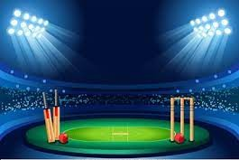
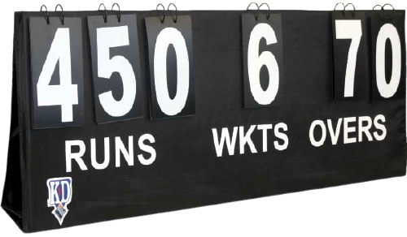
CRICKET SCORE
SHEET
IN C
By-
1. Karan Nayal
2. ShreshthTiwari

Slide 2
CONTENTS
Scoring in Cricket.
What is a Cricket Scoresheet?
Our Project.
Program flow.
Output screen.

Slide 3
Scoring in Cricket
Scoring in cricket matches involves two elements –
The number of runs scored.
The number of wickets lost by each team.
A scorer is someone appointed to record all runs scored, all wickets taken and, where appropriate, the number of overs bowled. In professional games, in compliance with the Laws of Cricket, two scorers are appointed, most often one provided by each team.

Slide 4
Cricket Scoresheet
It is a made up of tables used for storing cricket related data in tabular format, like- runs, overs, wickets, etc.
Using the scoresheet, the scorer fills out two main sections per ball, the bowling analysis and the batting analysis. Each section helps track the number of balls bowled in an over, any extras (such as Wide Balls and No Balls) and also any wickets (or dismissals).

Slide 5
Our Project
Our project is to rebuilt the same scoresheet on paper to a scoresheet on computer screen with the help of powerful “C Programming Language”.
The scoresheet should be easy to edit.
It should auto calculate the overall scores, points and wikets by a team, thus saving the time of scorer.
Instead of searching all the scoresheets one by one, a scorer can easily access the scoresheet just with a press of button.

Slide 6
Program Flow
When the project file of cricket score sheet project is executed, it works by following the steps described below:
First of all the project displays the welcome screen and the screen fades up to display the main menu.
The main menu comprises three options namely:
  New Score Sheet
  View Score Sheet
  Exit

Slide 7
Program Flow
If ‘1’ is entered, Cricket Score Sheet project asks for the name of new score sheet. When the file is created, a message is displayed on the screen.
Then, the score sheet appears on screen in which the user has to input the following information:
(i) Competition (ii) Venue
(iii) Match between and versus
(iv) Toss winner team (iv) Inning and date
(v) Elected choice of toss winner
(vi) Name of batsman and run hit by each of them
(vii) Name of bowler and run given by each blower

Slide 8
Program Flow
After inputting these data, the program asks user to input ‘e’ to edit the data and ‘c’ to continue.
If the user inputs ‘2’ in the main menu, the program asks for the name of file. If the file is found, it is displayed. Otherwise, error message is printed on the screen.
The third option in main menu is exit. If ‘3’ is entered in the main menu, the Cricket Score Sheet project terminates.

Slide 9
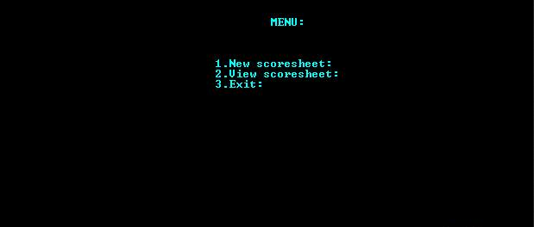
Output Screen

Slide 10
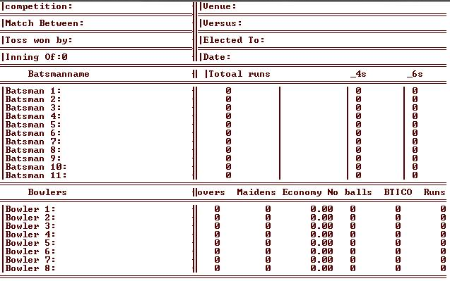
Output Screen

Slide 11
THANK YOU

